Slide 1
Chronic Kidney Disease
By Elias Fedai
Bellevue University

Slide 2
Variables
Specific Gravity- is the density of a solution substance in a ratio to a known standard density.
Albumin- Protein responsible for many functions. One being, ensuring fluid doesn’t leak out of blood vessels.
Hemoglobin- Protein responsible for moving/transporting oxygen in blood.
Red blood Cell- blood cells that carries oxygen throughout the body.
Blood Pressure- Is the force of how strong blood is pushing against the walls of blood vessels.
Diagnosis- this variable indicates if the patient has or doesn’t have chronic kidney disease.

Slide 3
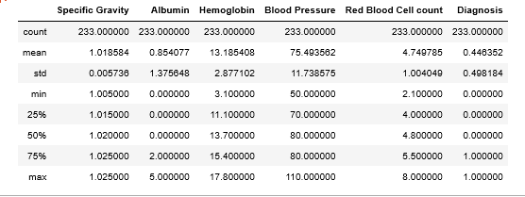
Central Tendency
Note: Good overall spread, blood pressure has a rather high standard deviation.

Slide 4
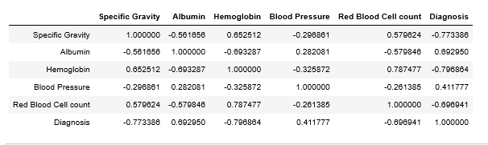
Correlation
Note: Our diagnosis variable appears to have pretty good correlations with all variables except blood pressure. Hemoglobin and red blood cell count also correlate well.

Slide 5
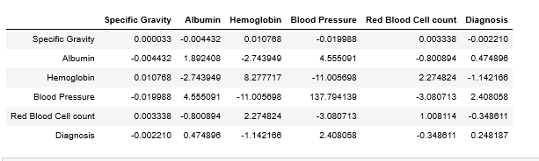
Covariance
Note: Specific gravity, Hemoglobin, RBC count display a negative relationship with our diagnosis. While all others display a positive relationship.

Slide 6
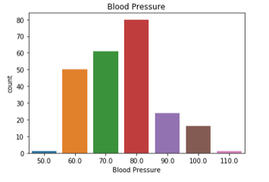
Blood Pressure Frequency
Note: Appears majority of participants appear to have 80mm/Hg blood pressure. Not much correlation or relationship between blood pressure and the other variables. No data given to indicate diastolic or systolic.

Slide 7
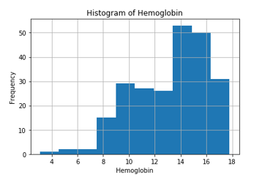
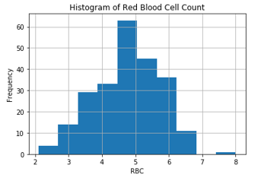
Histograms
Note: both display skewness of some degree to the left. Both parameters correlate very well and display a positive relationship. Appears there may be few outliers but this may be due to smaller sample size or true rare occurrence, also the sample source was never noted. In this situation I would leave these outliers in place and not remove.
Notes:
Histograms

Slide 8
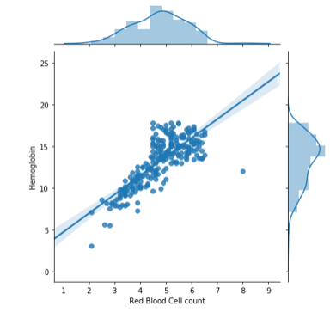
Hemoglobin and RBC
Note: Strong positive linear relationships appears to be present between these variables. This could cause problems in our regression analysis.

Slide 9
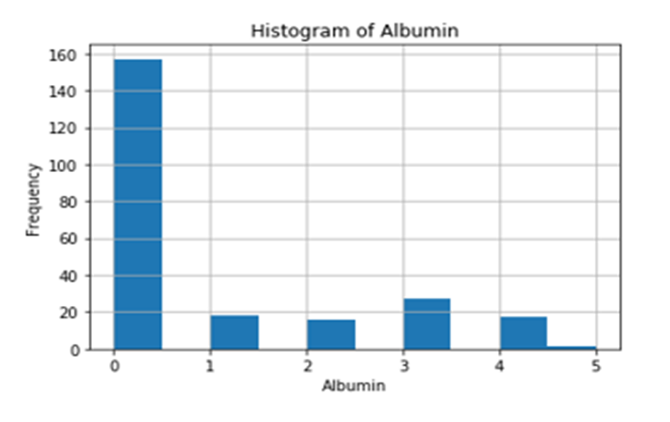
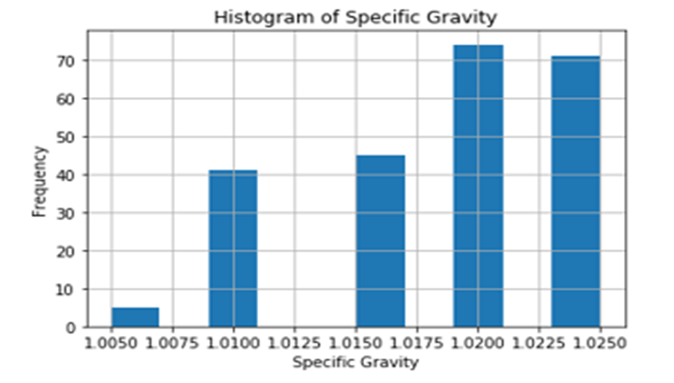
Histograms
Note: both histograms display some degree of skewness along with some degree of correlation and a negative relationship.

Slide 10
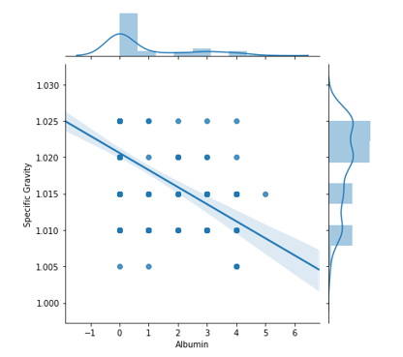
Specific gravity vs Albumin
Note: there appears to be a negative relationship, but very weak if any linear relationship.

Slide 11
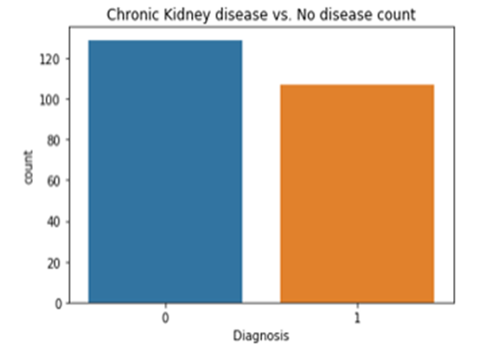
Binary variable graph
Note: 0 refers to no disease , and 1 refers to disease (more non disease in data set.)

Slide 12
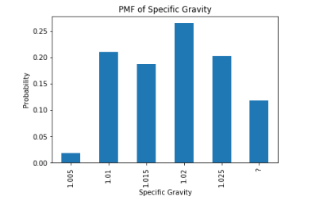
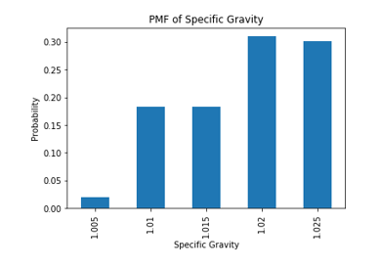
PMF- Pre and Post data clean
Pre
Post
Note: graph (left) displays false obscured data due to duplicates, etc., and graph on the right is post cleaning, very evident differences.

Slide 13
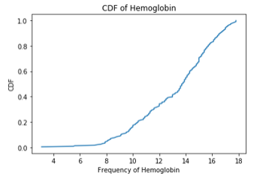
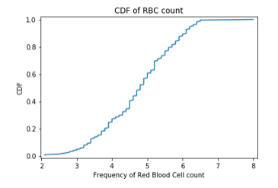
CDF for Hemoglobin and RBC
Note: Both CDF’s appears to display that 80% of patients appear to have hemoglobin of approximately 16 or less and an RBC count of approximately 5.8 or less.

Slide 14
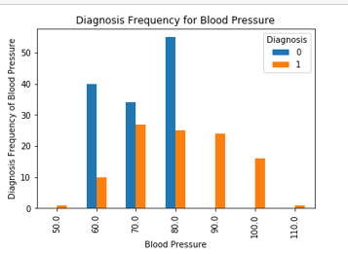
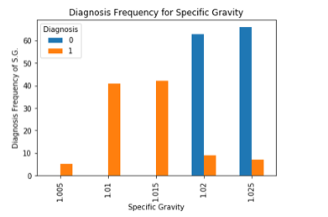
Bi-variable analysis
Note: Frequency graph for blood pressure displays a higher number of kidney disease for higher blood pressure values. Frequency graph for specific gravity displays higher number of kidney disease for lower values.

Slide 15
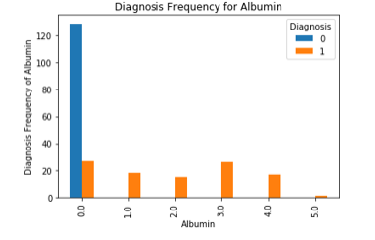
Bi-Variable analysis diagnosis/Albumin
Note: appears majority of patients with chronic kidney disease report having higher albumin values.

Slide 16
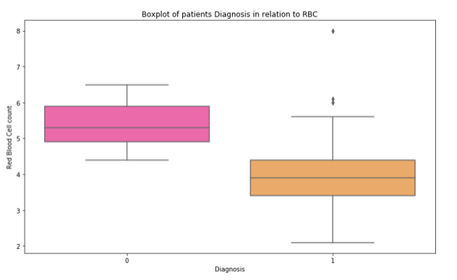
Box plot Diagnosis in relation to RBC
Note: Appears patients with no kidney disease display higher RBC counts. Also, few patients with disease display higher values than the majority (outliers).

Slide 17
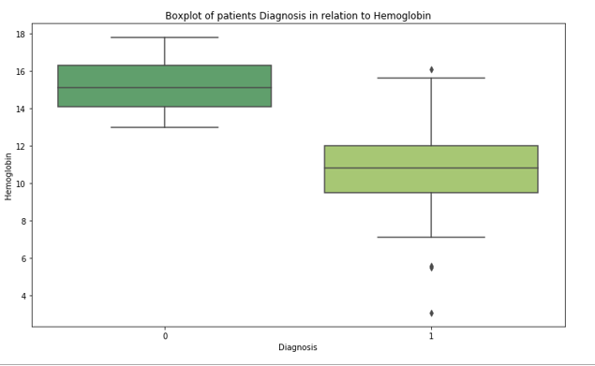
Box plot Diagnosis in relation to hemoglobin
Note: Appears patients with no disease also display higher hemoglobin which correlates well with the RBC count. Few outliers remain on the patients with the disease hemoglobin on both the low and high end.

Slide 18
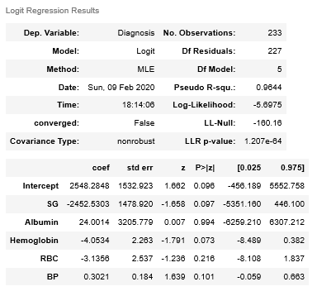
Logistic Regression Analysis
Note: This analysis appears to be statistically significant, thus leading us not able to reject the null hypothesis.(nonrobust displays possible outliers(remember the RBC count/hemoglobin boxplot), p-value less than 0.05 and R^2 of 96.4%).

Slide 19
Final Thoughts
Based on Analysis, Hemoglobin(Hgb) and Red blood cell count(Rbc) displayed a strong positive relationship. Which is expected as Hgb is a component of Rbc.
The Strong correlation between Hgb and Rbc is of concern to our model. Recommend reanalysis by removing one of these variables out of the dataset.
All variables appeared to display correlation to our target variable(diagnosis) except for blood pressure.
Our logistic analysis displayed that our model indicted that our variables are significant in predicting chronic kidney disease.
Our data source never indicated where the source of these results came from(i.e. blood stream, body fluid, urine, etc.) or methodology.
Based on our results, we cannot reject our null hypothesis.

